Slide 1

At a Crossroads and Searching the Navigation System
Yield for Positive Outcomes When FAPE Intersects with Co-Teaching, Specially Designed Instruction, Universal Design for Learning and High Leverage Practices.

Slide 2

Yield for Positive Outcomes When Free Appropriate public Education (FAPE) Intersects with Co-Teaching, Specially Designed Instruction, Universal Design for Learning and High Leverage Practices.

Slide 3

It’s time to REVISE our Co-Teaching PRACTICES.
This Photo by Unknown Author is licensed under CC BY-SA-NC
This Photo by Unknown Author is licensed under CC BY-SA

Slide 4
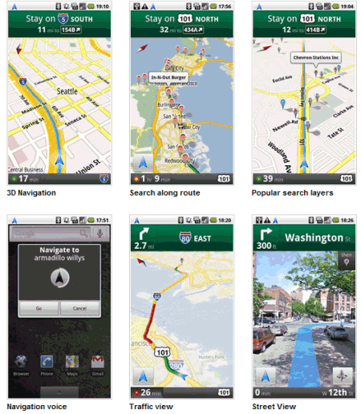
NAVIGATING THE Components
FREE APPROPRIATE PUBLIC EDUCATION
SPECIALLY DESIGNED INSTRUCTION
CO-TEACHING
UNIVERSAL DESIGN FOR LEARNING
HIGH LEVERAGE PRACTICES
This Photo by Unknown Author is licensed under CC BY
This Photo by Unknown Author is licensed under CC BY-NC-ND

Slide 5
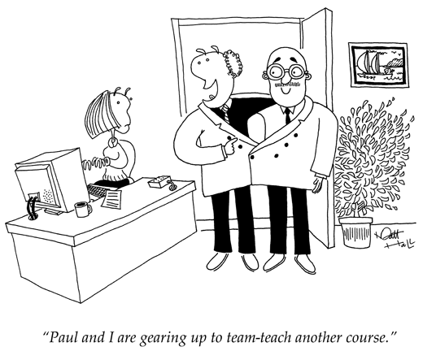
Co-teaching, as a service delivery option, has been adopted by most school systems and has become part of the culture of the American school.
This Photo by Unknown Author is licensed under CC BY

Slide 6
What are your thoughts about CO-TEACHING?
What do your colleagues say?
What do parents and advocates believe?
What have students shared?

Slide 7
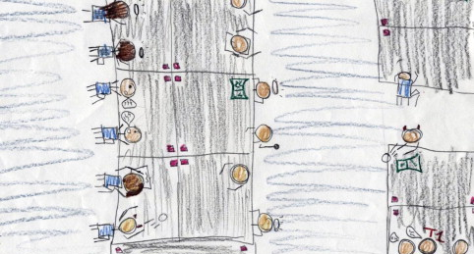
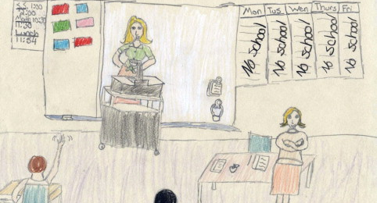
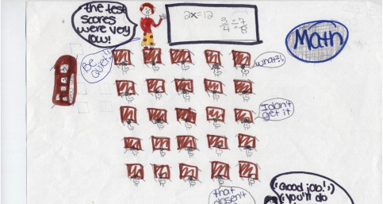
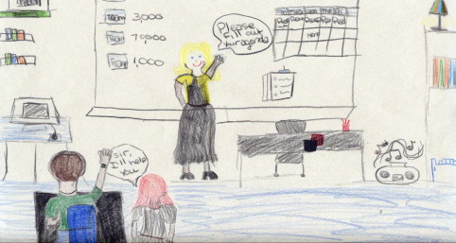
Students’ Perceptions

Slide 8
WHY REVISE Co-TEACHING PRACTICES?
One goal of co-teaching is to deliver specially-designed instruction in the least restrictive environment of the general education classroom.
Over the last decade we have lost sight of the goal of this service delivery model.
Although co-teaching has become the norm, the delivery of specially-designed instruction has become secondary.

Slide 9
Teachers’ Perceptions
“Students with disabilities take too much of my classroom time away from the other students.”
“Why should I do their job? I have a job of my own.”
“I can’t implement the IEP without a special educator or paraeducator in the room.”
“The special educator’s job should support the general educator in the co-teaching partnership”
“I don’t know how to teach student’s with disabilities.”
“My curriculum has DI and UDL embedded. Isn’t that specialized instruction?”
“I don’t know how I’ll ever co-teach with so many teachers AND meet the IEP goals!! “
“The special educator is responsible for IEP goals. I make sure the accommodations are provided.”
“In a co-taught classroom, the special educator can’t be expected to support the neediest students. Those students should be in another classroom. The co-teachers have an entire classroom of students who can not be “sacrificed” for one student.”

Slide 10

FAPE
“In rejecting the Tenth Circuit’s reasoning, the Supreme Court determined that, “[t]o meet its substantive obligation under the IDEA, a school must offer an IEP [individualized education program] that is reasonably calculated to enable a child to make progress appropriate in light of the child’s circumstances.” The Court additionally emphasized the requirement that “every child should have the chance to meet challenging objectives.”
This Photo by Unknown Author is licensed under CC BY-SA-NC

Slide 11

SPECIALLY DESIGNED INSTRUCTION
The Individualized Education Program (IEP) provides the pathway to implementing specifically designed instruction.
Co-teaching and its approaches are intended to support the delivery of SDI.
This Photo by Unknown Author is licensed under CC BY-NC-ND

Slide 12
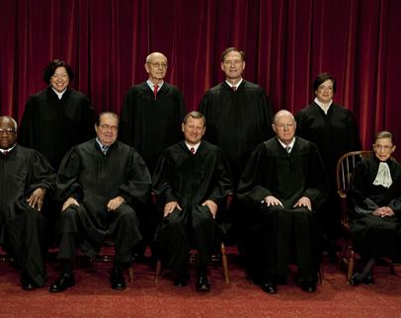
Specially Designed Instruction
Specially designed instruction (SDI) should narrow the gap in the performance of students with disabilities compared with their same age peers.
In the Endrew, F. v. Douglas County School District (2017) decision, the Supreme Court clarified that IEPs must be “reasonably calculated to enable a child to make progress” appropriate in light of their circumstances, and that while the child’s goals may be different, “every child should have the chance to meet challenging objectives.”
This Photo by Unknown Author is licensed under CC BY-NC-ND

Slide 13

Specially Designed Instruction
IDEA defines specially designed instruction as adapting, as appropriate to the needs of a student, the
content
methodology
delivery of instruction
  co-teaching
This Photo by Unknown Author is licensed under CC BY-SA

Slide 14

Co-Teaching and Specially Designed Instruction
The co-development, co-implementation, and co-evaluation of SDI is reliant on the collection and analysis of data attributed to student growth over time; data that originates as part of the general education framework, where high expectations drive results.
This Photo by Unknown Author is licensed under CC BY-SA-NC

Slide 15
IEP Development / Specially Designed Instruction
IEP Co-Development
Review
Review Present Levels of Functional Performance (PLAAFP).
Review
Review grade/age level standards/curriculum.
Identify
Identify priority skills for each area impacted by the student’s disability.
Develop
Develop annual goals and objectives to support priority skill attainment.
Determine
Determine Supplementary Aids and Services and Accommodations necessary to ensure access to the general education curriculum.
Plan
Plan for the implementation of IEPs.

Slide 16
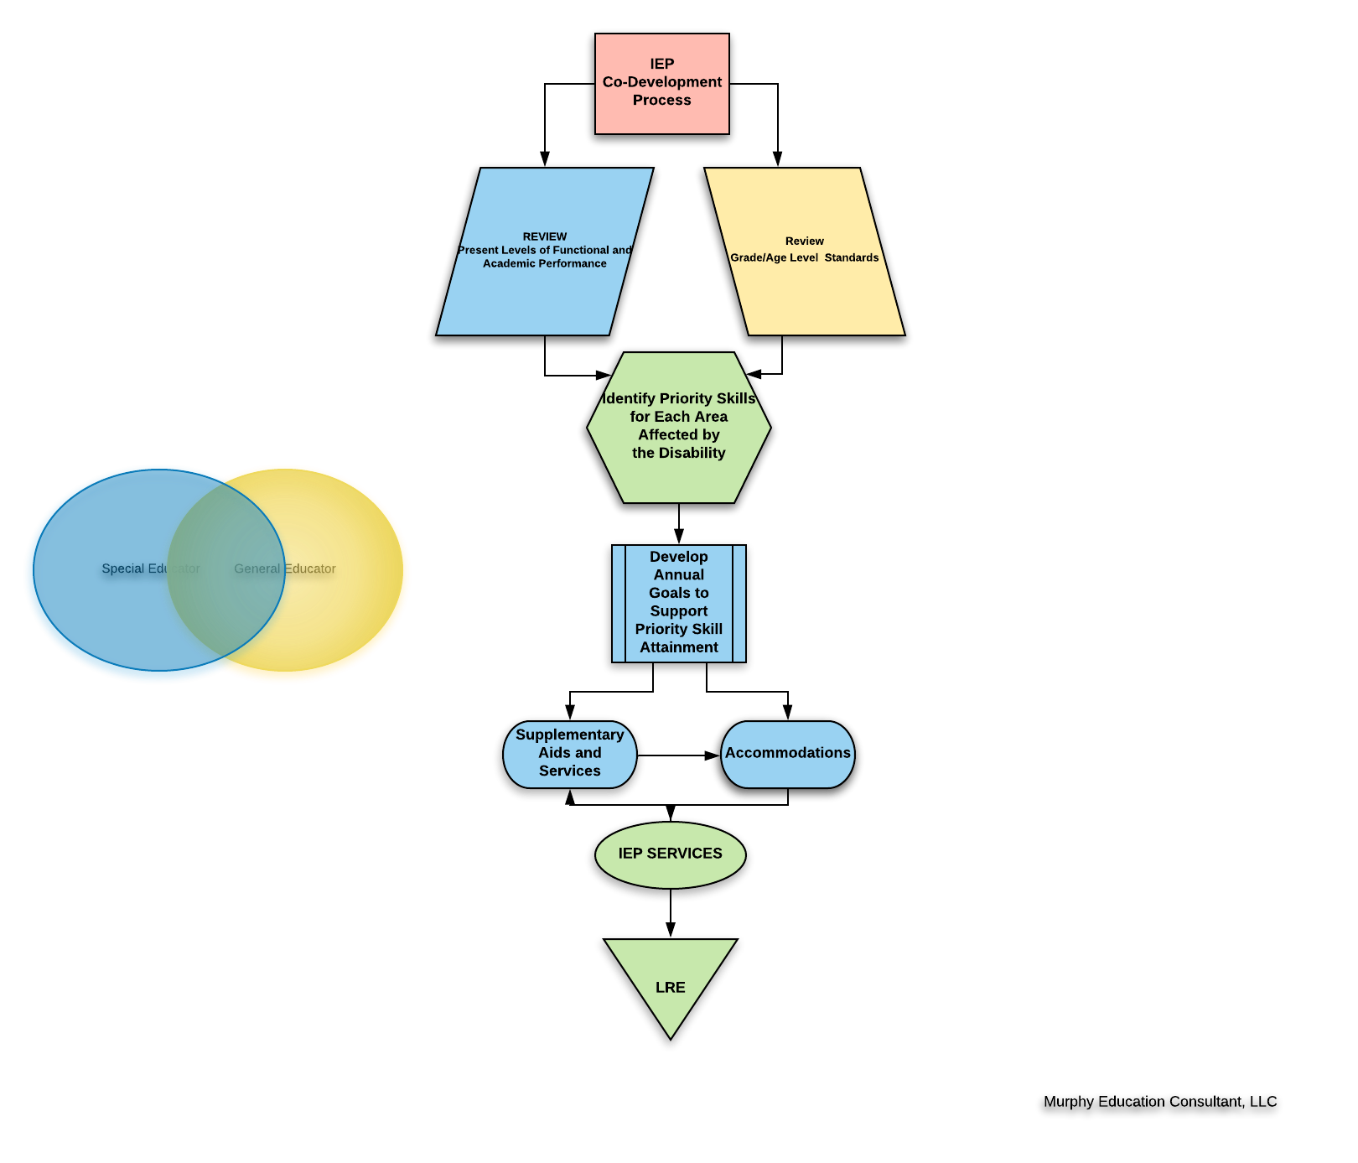

Slide 17






Co-Teaching
UDL
HLPs
CO-DEVELOPMENT
CO-IMPLEMENTATION
CO-EVALUATION
CO-TEACHING MODELS
STANDARDS/
CURRICULUM

Slide 18

Co-Planning
Plan for Design and Delivery of SDI
  Identify roles and responsibilities of general and special educators
  Identify timelines and co-teaching approaches
  Identify processes and procedures for progress monitoring and data collection aligned to IEP goals and objectives as well as curriculum goals and objectives.
This Photo by Unknown Author is licensed under CC BY-NC-ND

Slide 19
Planning
Review
Review the Standards/General Education Curriculum
Review
Review SDI Components for Students with Disabilities

Slide 20

Unit Planning
Review
Review curriculum standards, objectives, assessments, and essential skills.
Review
Review student IEPs.
Identify
Identify points throughout the unit that may present barriers to learning.
This Photo by Unknown Author is licensed under CC BY-NC-ND

Slide 21
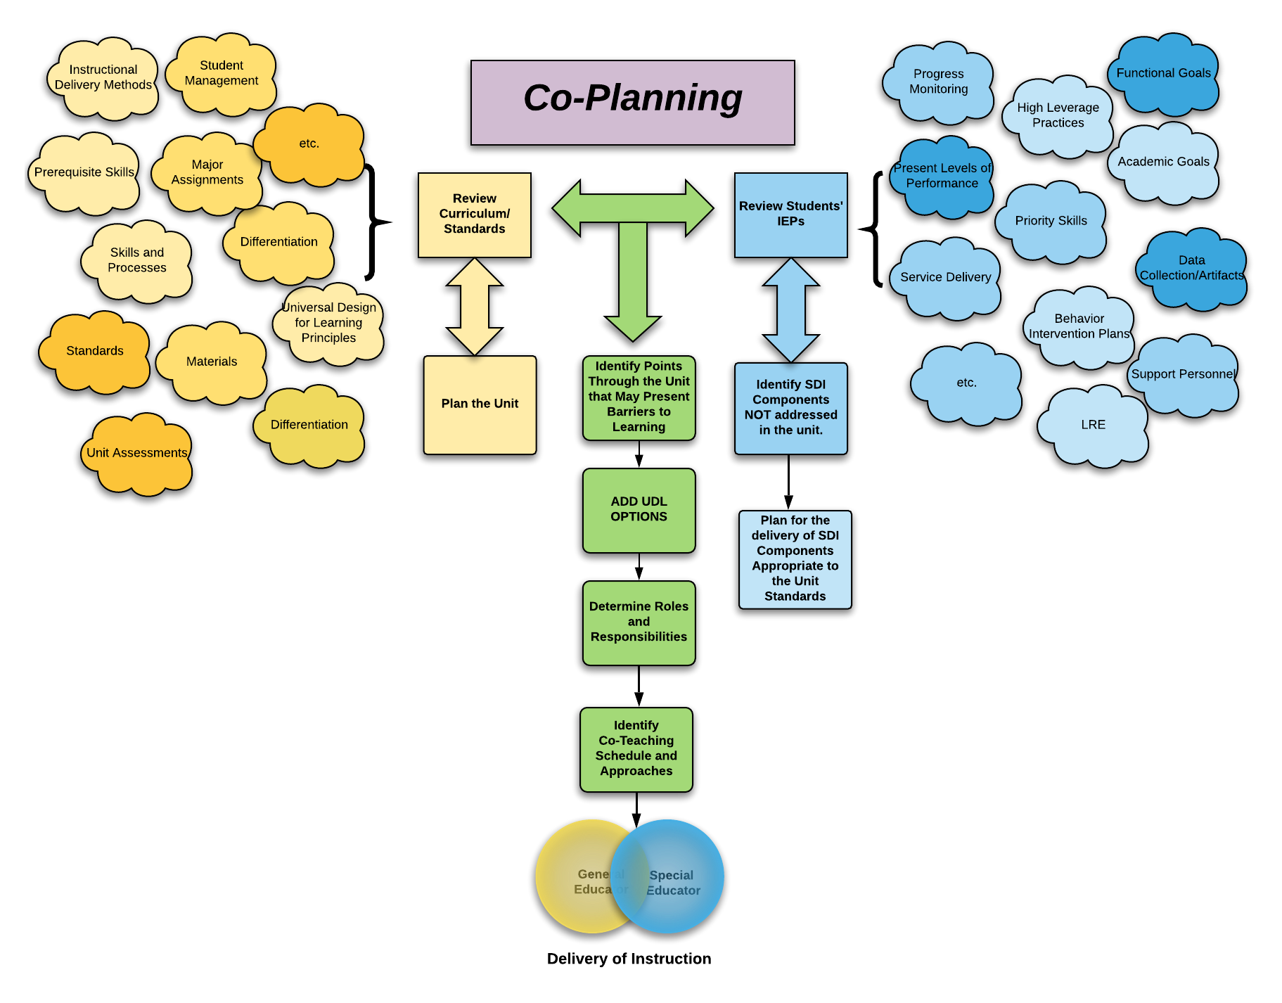

Slide 22
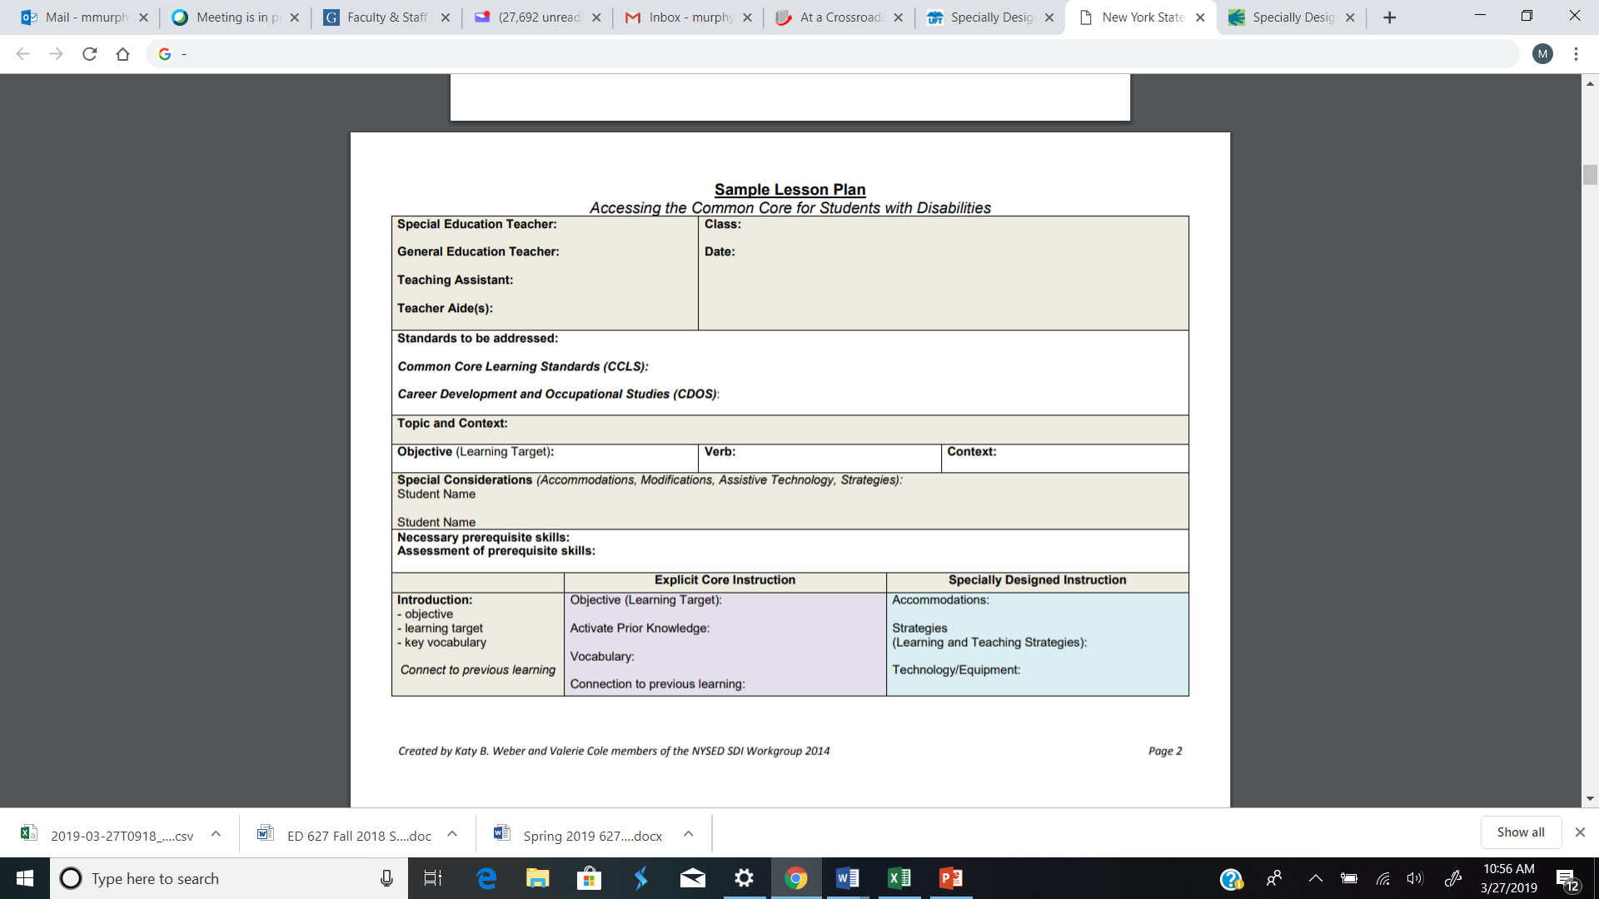

Slide 23
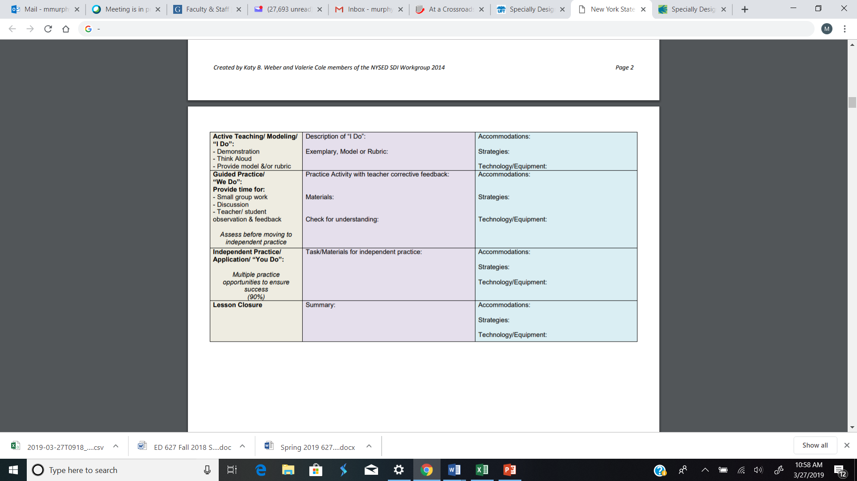

Slide 24
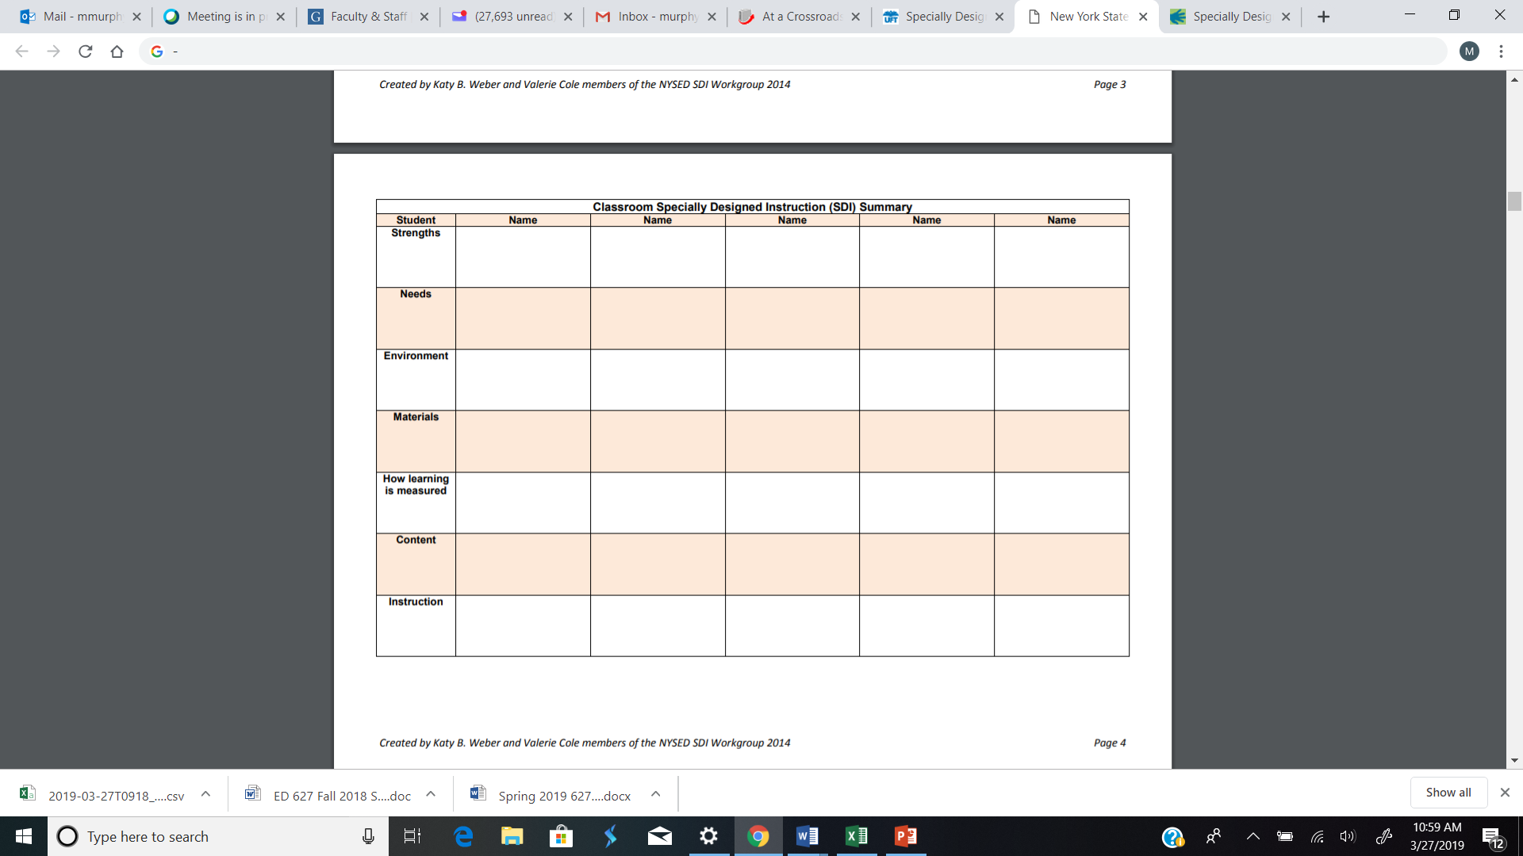

Slide 25
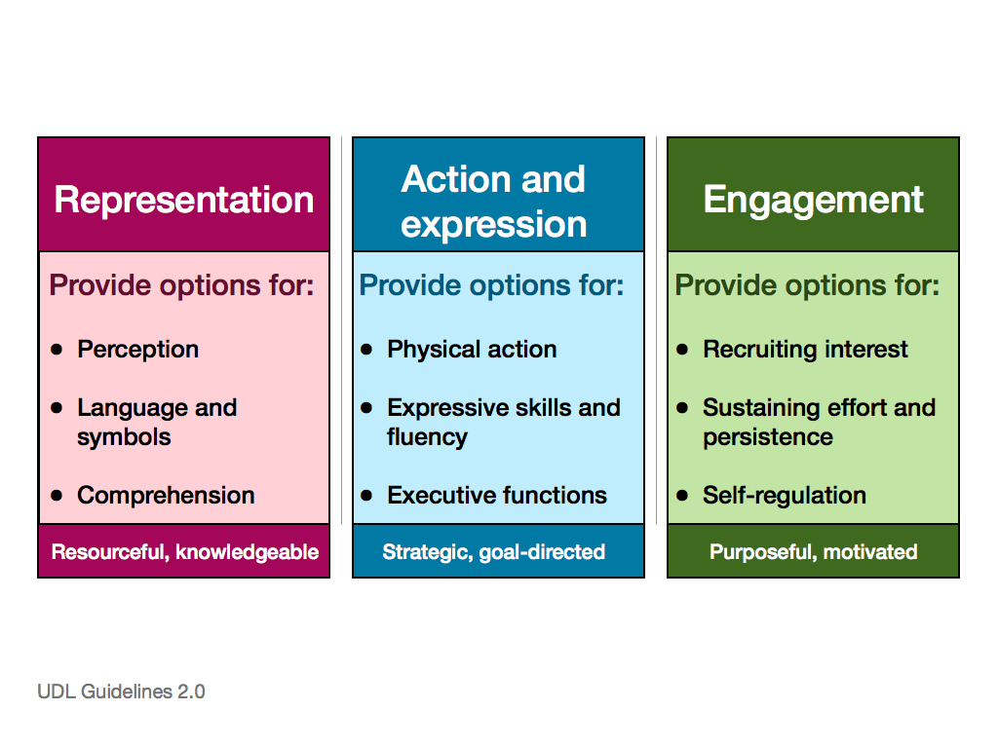
Decrease Barriers to Learning
Incorporate the Principles of Universal Design for Learning.
  The WHAT of LEARNING
  The HOW of LEARNING
  The WHY of LEARNING
This Photo by Unknown Author is licensed under CC BY-NC

Slide 26

Universal Design for Learning
Universal Design for Learning (UDL) is a framework to improve and optimize teaching and learning for all people based on scientific insights into how humans learn.
This Photo by Unknown Author is licensed under CC BY-SA-NC
Notes:
http://www.cast.org/our-work/about-udl.html#.XGdY3ehKhPY

Slide 27
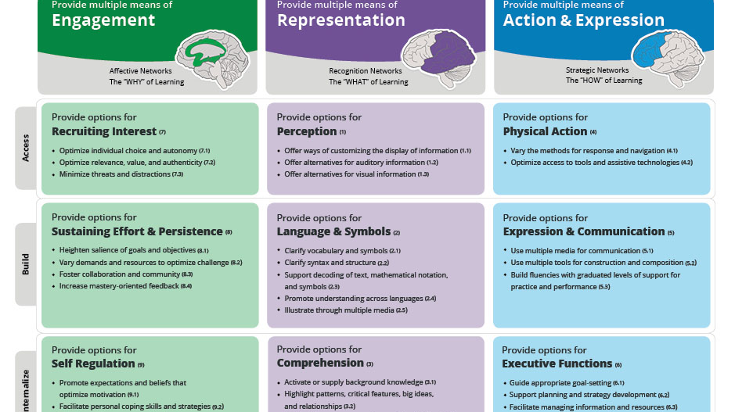
This Photo by Unknown Author is licensed under CC BY-SA

Slide 28
The WHAT of LEARNING
Use Concept Maps to clarify the relationship between ideas.
Use the EASE of ACCESS tools and speech to text capabilities at Dictation.io
Embed visual, non-linguistic supports for vocabulary clarification (pictures, videos, etc.)

Slide 29
The HOW of LEARNING
Compose in multi-media
Use interactive web tools
Provide sentence starters or sentence strips
Use virtual or concrete manipulatives
Provide scaffolds
Provide multiple novel examples to authentic problems
Facilitate executive functioning

Slide 30
The WHY of LEARNING
Include
Include individual choice and autonomy.
Minimize
Minimize threats and distractions.
Vary
Vary the level of novelty and risk
Vary
Vary the level of sensory stimulation
Foster
Foster collaboration and community

Slide 31
High-Leverage Practices
High-Leverage Practices
Collaboration
Assessment
Social/Emotional/Behavioral Practices
Instruction

Slide 32
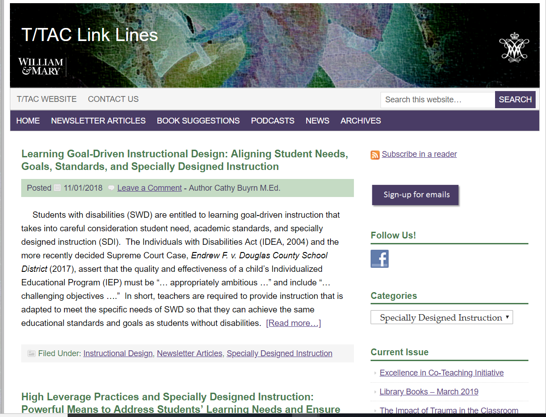
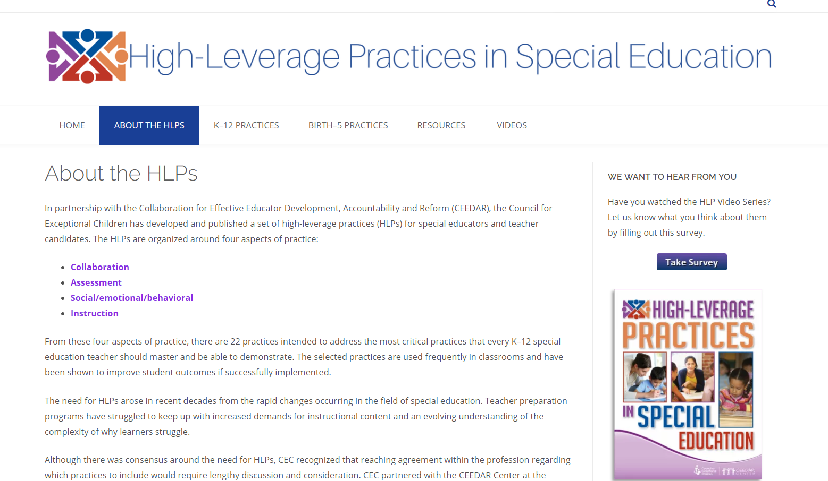
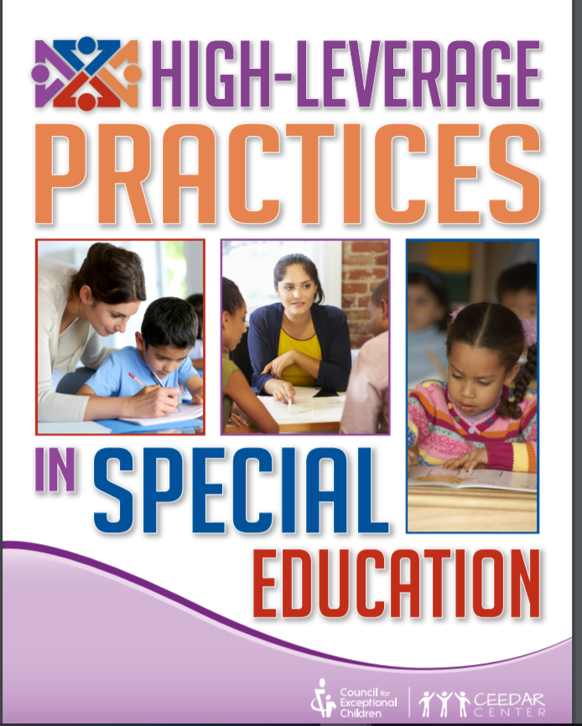
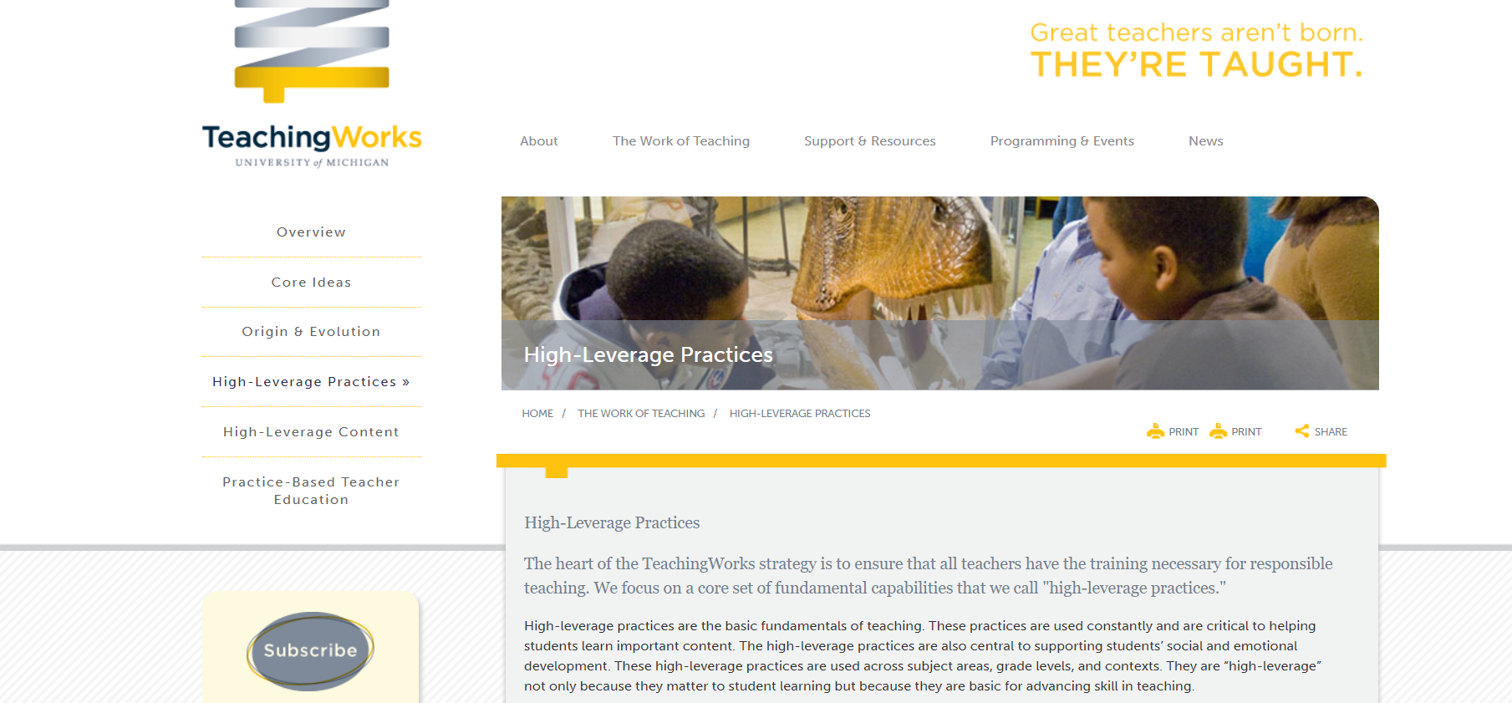
Resources
High-Leverage Practices

Slide 33
Collaboration Components of SDI
HLP 1
Collaborate with professionals to increase student success.
HLP 2
Organize and facilitate effective meetings with professionals and families.
HLP 3
Collaborate with families to support student learning and secure needed services.

Slide 34
Assessment Components of SDI
HLP 4
Use multiple sources of information to develop a comprehensive understanding of a student’s strengths and needs.
HLP 5
Interpret and communicate assessment information with stakeholders to collaboratively design and implement educational programs.
HLP 6
Use student assessment data, analyze instructional practices, and make necessary adjustments that improve student outcomes.

Slide 35
Social/Emotional/Behavioral Components of SDI
HLP 7
Establish a consistent, organized, and respectful learning environment.
HLP 8
Provide positive and constructive feedback to guide a students’ learning and behavior.
HLP 9
Teach social behaviors.
HLP 10
Conduct functional behavioral assessments to develop individual student behavior support plans.

Slide 36
Instructional Components of SDI
HLP 11 Identify and prioritize long- and short-term learning goals.
HLP 12 Systematically design instruction toward specific learning goals.
HLP 13 Adapt curriculum tasks and materials for specific learning goals.
HLP 14 Teach cognitive and metacognitive strategies to support learning and independence.
HLP 15 Provide scaffolded supports.
HLP 16 Use explicit instruction.
HLP 17 Use flexible grouping.
HLP 18 Use strategies to promote active student engagement.
HLP 19 Use assistive and instructional technologies.
HLP 20 Provide intensive instruction.
HLP 21 Teach students to maintain and generalize new learning across time and settings.
HLP 22 Provide positive and constructive feedback to guide students’ learning and behavior.
Notes:
Explicit instruction is clear and outcome-driven. It is systematic and sequential, thereby reducing cognitive confusion, allowing students to focus their energy on one concept at a time. Teachers engage students by offering varied opportunities to respond, providing positive and targeted feedback, and preparing thoughtfully planned practice (McLeskey et al., 2017; Riccomini et al., 2017).
In the example below, a special education teacher working with a group of second grade students employs the principles of explicit instruction to introduce the vowel-consonant-e syllable type. Having already taught her students the concept of the short vowel closed syllable, the teacher uses colored-coded alphabet cards to teach the new syllable type. She states the rule directly, explaining that the “e” remains silent but signals a long vowel sound. The teacher employs finger spelling to demonstrate the reading of several words using an ‘I do’ approach as her students watch and listen. Next, she provides an opportunity for her students to practice the new concept as she works in tandem with them (we do) to read several carefully selected words. The teacher balances confirming and corrective feedback throughout the process. Finally, she encourages her students to independently practice decoding vowel-consonant-e words from a third list (you do). Once students have demonstrated mastery of reading one-syllable words comprised of vowel-consonant-e syllables, the teacher moves her students to the next level of mastery. Figure 2 below illustrates the color-coded alphabet cards used by the teacher to explicitly teach the vowel-consonant-e syllable.
Teachers use intensive instruction to match the severity of student need and close gaps between student performance and expected outcomes. Teachers target a small number of clearly articulated, high priority skills and concepts critical for academic success. Instruction may be intensified in a number of ways including reducing group size such that students with similar needs are grouped together. Groups may meet more often or for longer periods of time during the school day. Students then have more opportunities to learn and practice skills with immediate, corrective feedback. Instruction may also be intensified by providing more detailed explanations, modeling, and learning opportunities with visuals, manipulatives, and/or think-alouds; breaking instruction or tasks into smaller steps; and offering increased initial support that is gradually faded over time. IEP teams base decisions related to the frequency and intensity of the instruction delivered on a student’s performance data. Intensive instruction is considered a Tier 3 level intervention, and is delivered by special educators (McLeskey et al., 2017). For ideas on intensifying instructional delivery during guided reading follow this link.
In the example above, the teacher would monitor students’ progress via formative assessments to guide her daily instruction and to ensure that each student reaches the established instructional targets. If a student’s progress stalls, the IEP team would revisit the intervention and make adjustments.
Educators like Patricia and her co-teacher, should consider the 22 HLPs as outlined by McLeskey et at. (2017) when designing SDI for individual students. The IEP team determines if intensive intervention is necessary, and if so, identifies appropriate interventions and accommodations through consideration of a student’s strengths, specific learning needs, and the extent of academic gaps. The team then specifies the frequency and intensity of the instruction to be delivered and decides what evidence will be used to demonstrate proficiency. The process of planning and delivering SDI to address the unique needs of students with disabilities enables IEP teams to close academic gaps and move students forward.

Slide 37
Co-Teaching, Specially Designed instruction, and High Leverage Practices
Co-Teaching
HLPs
SDI
Notes:
While expectations for student performance have increased over the years, so too has our knowledge of effective instructional practices for use with students in general and special education. For students with disabilities, these instructional strategies are governed by the student’s special education teacher through the student’s Individualized Education Program (IEP). Riccomini, Morano, and Hughes (2017) describe Specially Designed Instruction (SDI) as instruction designed to support a student’s ability to access the general education curriculum while meeting the goals and objectives as outlined in the student’s IEP. The reauthorization of the Individuals with Disabilities Education Act (IDEA) 2006 and current IDEA regulations 2012 identify SDI as
adapting, as appropriate to the needs of an eligible child under this part, the content, methodology, or delivery of instruction (i) to address the unique needs of the child that result from the child’s disability; and (ii) to ensure access of the child to the general curriculum, so that the child can meet the educational standards within the jurisdiction of the public agency that apply to all children. (34 C.F.R. §300.39 [b] [3])
The Council for Exceptional Children and the Collaboration for Effective Educator Development, Accountability, and Reform (CEEDAR) Center identify 22 fundamental, research-based teaching practices referred to as high-leverage practices, or HLPs (see Table 2), that should be evident in any K-12 classroom (McLeskey, J., Barringer, M. D., Billingsly, B., Brownell, M., Jackson, D., Kennedy, M.,… & Ziegler, D., 2017). These practices aid student learning across tiers of support and educational settings. The HLPs address four interrelated components of special education: collaboration; assessment; social, emotional, and/or behavioral practices; and instruction. For several practices, links to additional resources are provided.
HLPs are a starting point for the selection, design, and implementation of SDI in light of a student’s special learning needs (Riccomini et al., 2017). Explicit and intensive instruction are two HLPs under Instruction, and are hallmarks of SDI (McLeskey et al., 2017; Riccomini et al., 2017) (See Figure 1). More discussion and examples of explicit and intensive instruction are provided below.

Slide 38
Co-Teaching Approaches
TEAM TEACHING
ONE TEACH/ ONE ASSIST
PARALLEL TEACHING
STATION TEACHING
ALTERNATIVE TEACHING
Co-Teaching Approaches MUST Support the Delivery of SDI !

Slide 39
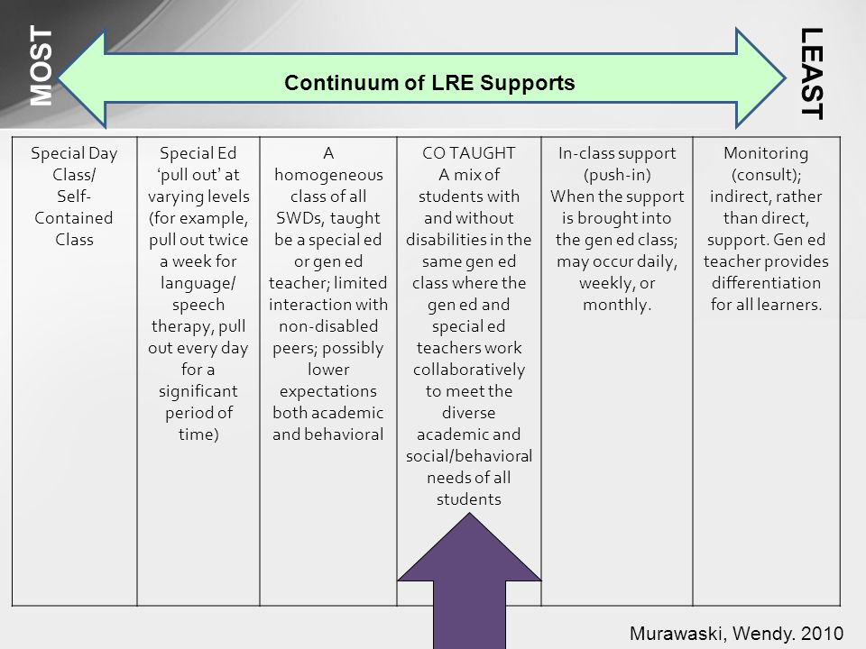
Co-Teaching May NOT be the best choice to ensure delivery of SDI.
Consider the continuum of LRE supports in light of the identified students’ needs.

Slide 40

It’s time to REVISE our Co-Teaching PRACTICES to focus on the Design and Delivery of SDI to ensure that we are providing FAPE AND Narrowing the Gap for students with disabilities.
This Photo by Unknown Author is licensed under CC BY-SA

Slide 41

Resources
Murphy Education Consultant, LLC
LIVE BINDER
IEP Development Process Visual
Co-Planning Process Visual

